Slide 1
A General Overview of Authority Control in Alma
Yoel Kortick
Senior Librarian
Sept. 2025

Slide 2
Agenda
Introduction
Global authorities in Alma
How does Alma know which vocabulary to use for subjects?
How does Alma know which vocabulary to use for names?
The difference between using F3 and not using F3
The job "Preferred Term Correction"
What's the whole point? Why are we doing this?

Slide 3
Introduction

Slide 4
Introduction
This presentation will deal with how bibliographic headings in Alma become linked to global authority records, and what the influence of that linking is on both the staff user in Alma and the end user in Discovery. A separate presentation deals with local authority records.
It is assumed that the audience already knows the purpose of authority control, which stated briefly, is
  To organize headings into single authorized terms with "see", "seen from" and "see also" terms.
  To not merely engage in an academic exercise, but rather to ultimately aid the end user in finding desired material.

Slide 5
Global authorities in Alma

Slide 6
Global authorities in Alma
The Alma Community Zone (CZ) contains 55 different authority vocabularies (as of July 2025), each of which is automatically updated on a regular basis.
The full list of these authority vocabularies and the update frequency may be viewed at Authority Vocabularies in the Community Zone.

Slide 7
Global authorities in Alma
An authorized name or subject will appear differently according to the authority vocabulary.
Let us take the example "Shneur Zalman of Lyady" and see the different ways this name appears in different vocabularies.
The next slide shows different ways the authorized name appears in six different vocabularies.

Slide 8
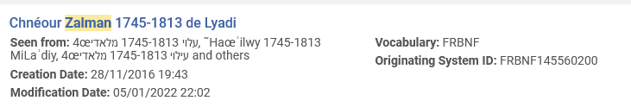
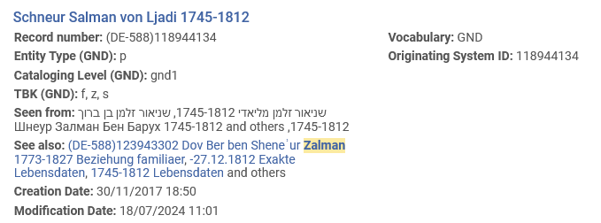
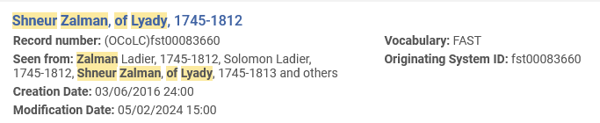
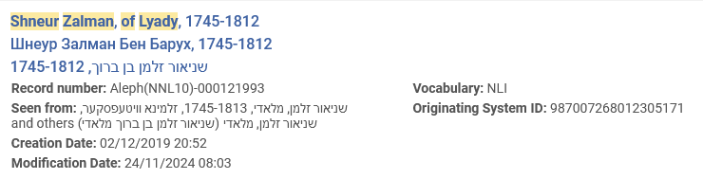
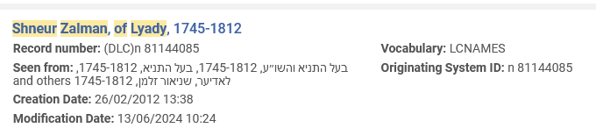
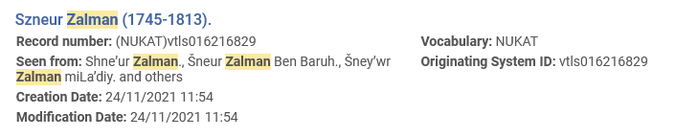
Global authorities in Alma

Slide 9
Global authorities in Alma
In other cases, the authorized term may appear the same in different vocabularies but have different "seen from" and "see also" references.
The next slide shows subject heading "Cardiology" from vocabularies LCSH (Library of Congress Subject Headings) and MESH (Medical Subject Headings)
We see that while the authorized heading is the same, the "seen from" and "see also" references differ.
LCSH has no "seen from" headings but has two "see also" headings.
MESH has no "see also" headings but has six "seen from" headings.

Slide 10
Global authorities in Alma
LCSH | MESH
035## |a (DLC) sh 85020214 150_0 |a Cardiology 550_0 |a Heart |x Diseases 550_0 |w g |a Internal medicine | 035__ |a (DNLM)D002309 150__ |a Cardiology 450__ |w nnna |a Angiology 450__ |w nnna |a Cardiovascular Disease Specialty 450__ |w nnna |a Vascular Medicine 450__ |w nnna |a Disease Specialty, Cardiovascular 450__ |w nnna |a Medicine, Vascular 450__ |w nnna |a Specialty, Cardiovascular Disease

Slide 11
How does Alma know which vocabulary to use for subjects?

Slide 12
How does Alma know which vocabulary to use for subjects?
First, we will deal with subjects, and then with names.
For subjects, the 2nd indicator determines the vocabulary to be used.
For example:
If a bibliographic record has this then LCSH (Library of Congress Subject Headings) will be used:
  650_0 $$a Cardiology
If a bibliographic record has this then MESH (Medical Subject Headings) will be used:
  650_2 $$a Cardiology
If a bibliographic record has this then GND (German National Library) will be used:
  650_7 $$a Cardiology $$2 GND

Slide 13
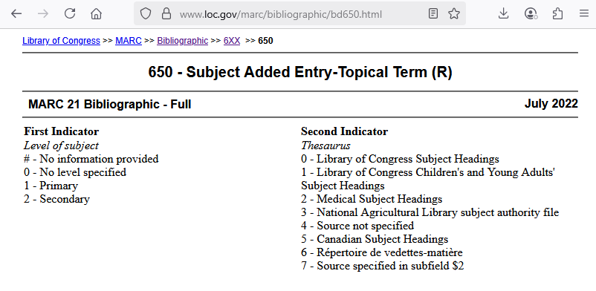
How does Alma know which vocabulary to use for subjects?
Alma (of course) follows the cataloging standards as described at https://www.loc.gov/marc/bibliographic/bd650.html

Slide 14
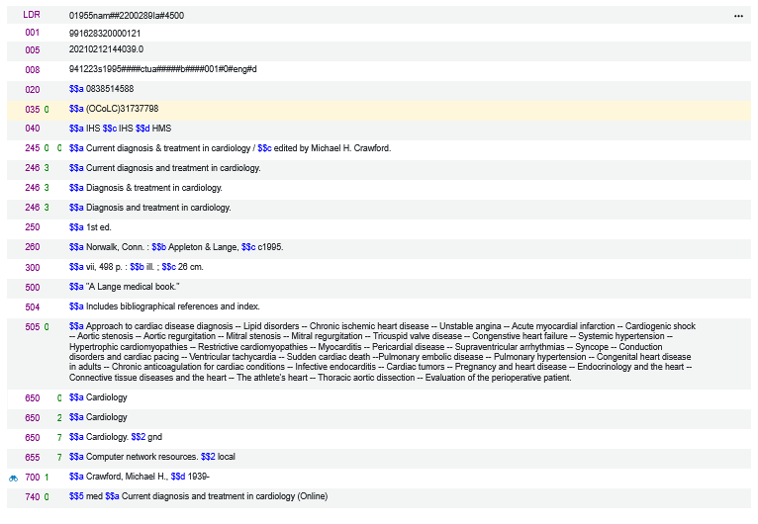

How does Alma know which vocabulary to use for subjects?
For demonstrative purposes we have catalogued one record with these three headings.

Slide 15
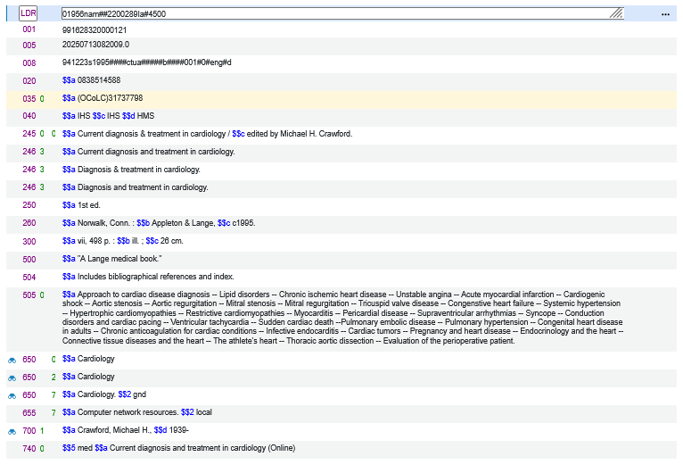

How does Alma know which vocabulary to use for subjects?
Upon save all three headings link to the relevant authority record (indicated by the binoculars icon)

Slide 16
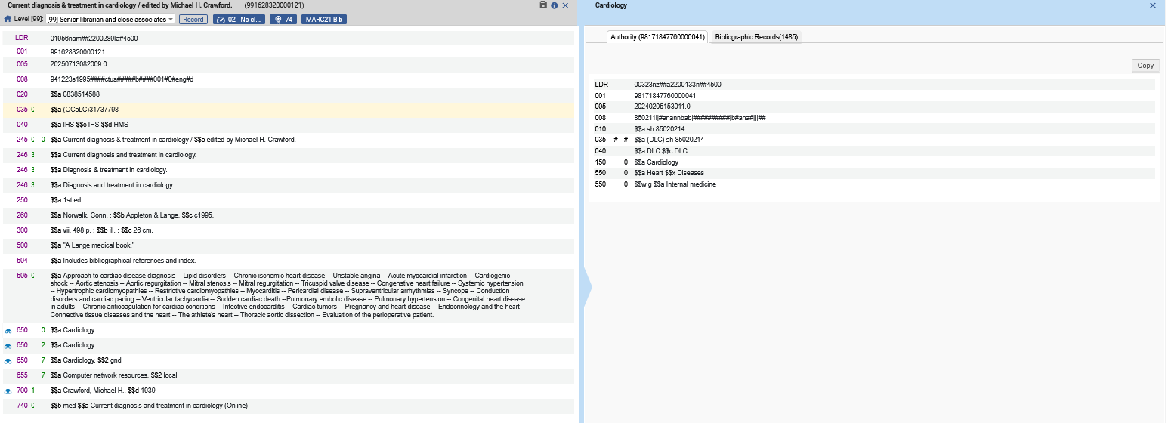
How does Alma know which vocabulary to use for subjects?
The heading with 2nd indicator 0 linked to a LCSH record

Slide 17
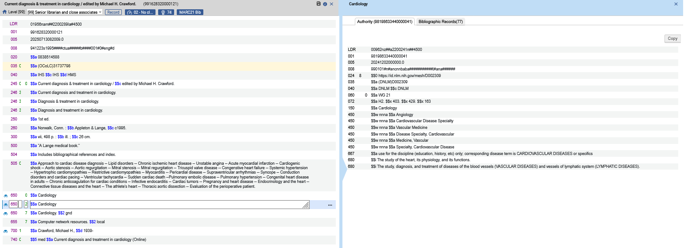
How does Alma know which vocabulary to use for subjects?
The heading with 2nd indicator 2 linked to a MESH record

Slide 18
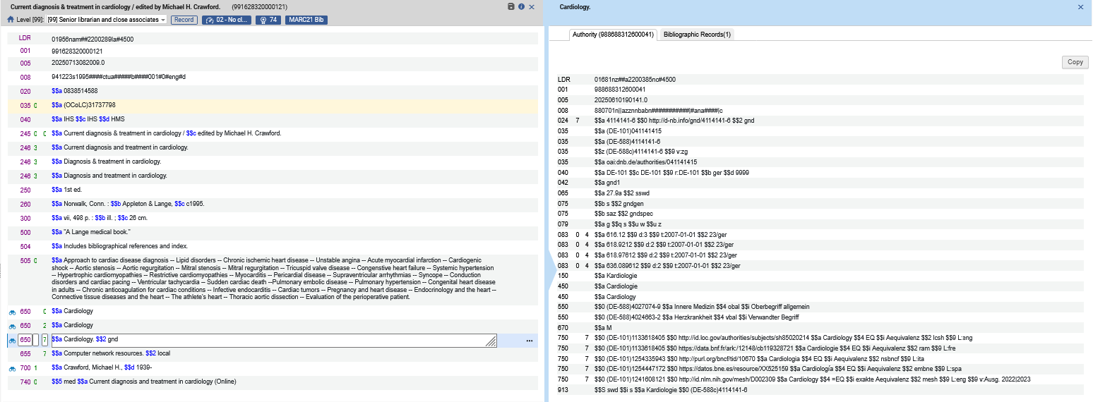
How does Alma know which vocabulary to use for subjects?
The heading with 2nd indicator 7 and subfield 2 GND linked to a GND record

Slide 19

How does Alma know which vocabulary to use for subjects?
The GND heading was linked to a non preferred term. After the job "Authorities - Preferred Term Correction" runs (more about this job later) the heading changes to the preferred GND term.

Slide 20
How does Alma know which vocabulary to use for names?

Slide 21
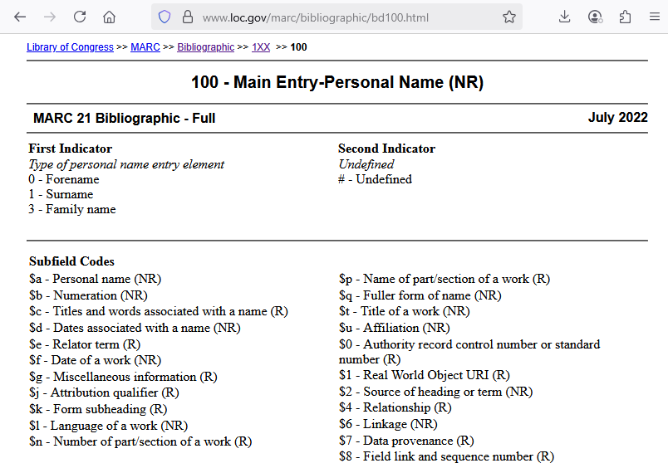
How does Alma know which vocabulary to use for names?
Names fields, such as 100 and 700, do not have a 2nd indicator to determine which vocabulary will be used. This can be seen at https://www.loc.gov/marc/bibliographic/bd100.html

Slide 22
How does Alma know which vocabulary to use for names?
Alma determines which authority vocabulary will be used when a heading is linked to an authority record via the parameter "authority_names".
This parameter is defined during implementation and can be changed at a later date by contacting Ex Libris support via a support case.

Slide 23
How does Alma know which vocabulary to use for names?
The parameter "authority_names" is used
To determine which vocabulary (or vocabularies) is used when looking for a match in the authority vocabulary for the bibliographic name heading
To determine which vocabularies will appear when doing F3 from a bibliographic name heading
This parameter may contain multiple vocabularies. When that is the case if no match is found for the first vocabulary, Alma looks for a match in the second vocabulary.

Slide 24
How does Alma know which vocabulary to use for names?
Here are five sample authority_names examples

Slide 25
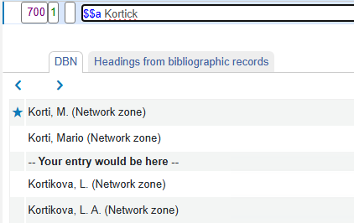
How does Alma know which vocabulary to use for names?
In order to know what authority_names is defined in your institution you can enter any text into a names field in a bibliographic record, for example 100 $$a, and then do "Open Authority Headings" (F3).
The following example means that authority_names is defined as "DBN" (Deskryptory Biblioteki Narodowej – Poland).

Slide 26
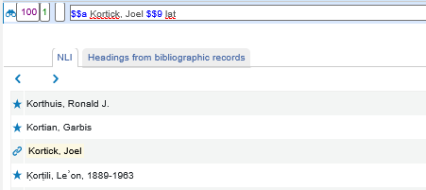
How does Alma know which vocabulary to use for names?
The following example means that authority_names is defined as "NLI" (National Library of Israel).

Slide 27
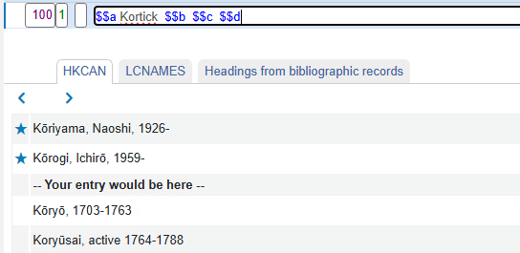
How does Alma know which vocabulary to use for names?
The following example means that authority_names is defined as "HKCAN,LCNAMES".
Alma will first look for a match in the HKCAN (Hong Kong Chinese Authority Name ) vocabulary and if a match is found Alma will stop.
If a match is not found, then Alma will look in LCNAMES (Library of Congress Names Authority File)

Slide 28
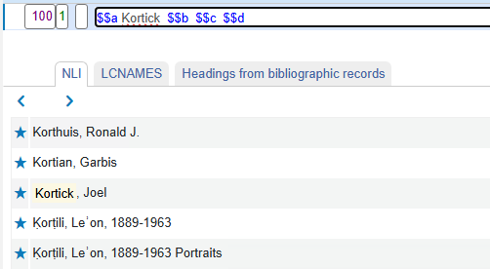
How does Alma know which vocabulary to use for names?
The following example means that authority_names is defined as "NLI,LCNAMES".
Alma will first look for a match in the NLI (National Library of Israel) vocabulary and if a match is found Alma will stop.
If a match is not found, then Alma will look in LCNAMES (Library of Congress Names Authority File)

Slide 29
How does Alma know which vocabulary to use for names?
To see how the authority_names effects the linking of a bibliographic heading we will do as follows:
  Institution A is defined as "authority_names = LCNAMES"
  Institution B is defined as "authority_names = GND"
  In both institutions we will catalog "100 $$a Muller, Fridrich Gottlieb"
  Heading "Muller, Fridrich Gottlieb"
    Does not exist as a name in LCNAMES
    Does exist as a name in GND
  We will therefore expect
    No link to be created for the name in institution A
    A link to be created for the name in institution B
EU02 EXLDEV1_INST LCNAMES
EU03 EXLDEV1_INST GND

Slide 30
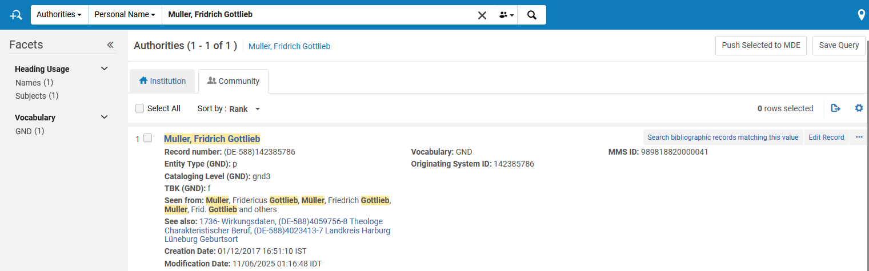
How does Alma know which vocabulary to use for names?
Here a search for authorities for name "Muller, Fridrich Gottlieb" in the CZ shows us that this name exists only for GND vocabulary

Slide 31
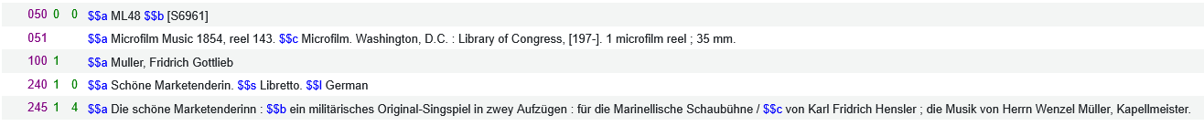
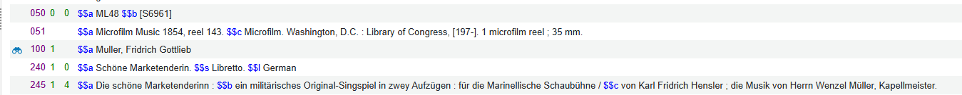
How does Alma know which vocabulary to use for names?
The record in institution A, where "authority_names = LCNAMES", does not get linked
The record in institution B, where "authority_names = GND", does get linked

Slide 32
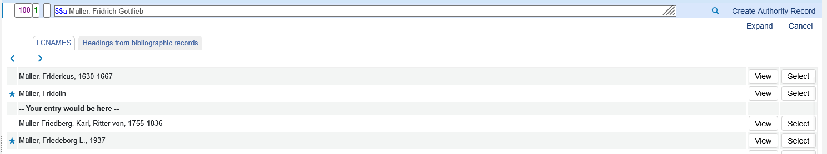
How does Alma know which vocabulary to use for names?
When we do "Open Authority headings " (F3) from institution A we see the list of LCNAMES headings (because this institution is defined to use LCNAMES in "authority_names" parameter)

Slide 33
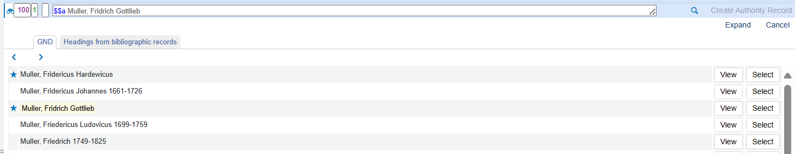
How does Alma know which vocabulary to use for names?
When we do "Open Authority headings " (F3) from institution B we see the list of GND headings (because this institution is defined to use GND in "authority_names" parameter)

Slide 34
The difference between using F3 and not using F3

Slide 35
The difference between using F3 and not using F3
F3 is "Open Authority Headings"
If a bibliographic heading is a non-preferred term then
  When the record is saved the bibliographic heading links to the authority heading and remains with the non-preferred text until the job "Authorities - Preferred Term Correction" runs.
  When F3 is used to select the non-preferred term the bibliographic heading links to the authority heading and changes to the preferred term.
Let’s see what we mean.

Slide 36
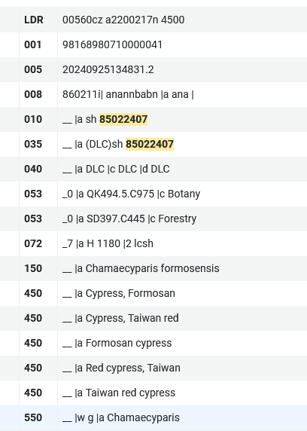
The difference between using F3 and not using F3
"Taiwan red cypress" is an LCSH non-preferred term for "Chamaecyparis formosensis"

Slide 37
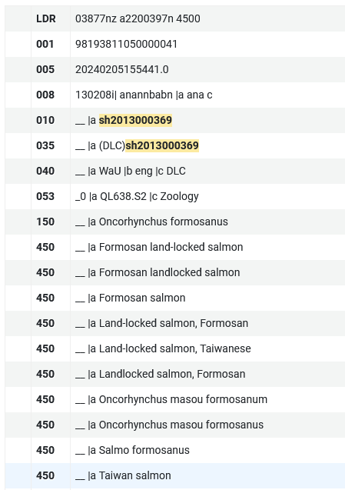
The difference between using F3 and not using F3
"Taiwan salmon" is an LCSH non-preferred term for "Oncorhynchus formosanus"

Slide 38
The difference between using F3 and not using F3
Now for demonstrative purposes we will catalog a record with the following two non-preferred terms in the following fields:
  650_0 $$a Taiwan red cypress
  650_0 $$a Taiwan salmon
For "Taiwan red cypress" we will do F3 and see that it links to preferred term "Chamaecyparis formosensis"
For "Taiwan salmon" we will only save the record and see that it links to non-preferred term "Taiwan salmon"

Slide 39
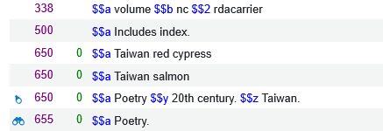
The difference between using F3 and not using F3
Now we will do F3 on 650_0 $$a Taiwan red cypress
We will do F3 with cursor here

Slide 40
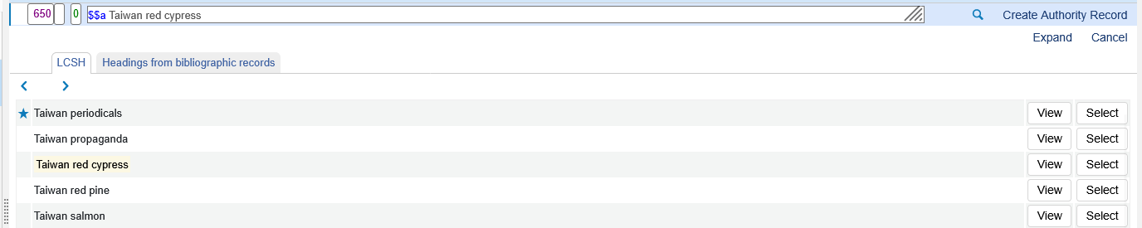
The difference between using F3 and not using F3
We will click "Select" on non-preferred term "Taiwan red cypress"

Slide 41
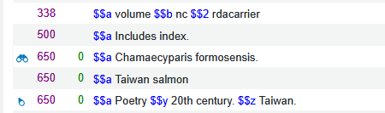
The difference between using F3 and not using F3
Non-preferred term "Taiwan red cypress" changed to preferred term "Chamaecyparis formosensis" and is linked to the authority heading

Slide 42
The difference between using F3 and not using F3
Now we will not do anything regarding the non preferred term "Taiwan Salmon" in subfield a of 650_0. We will merely save the record.
Let’s see what happens to this after saving

Slide 43
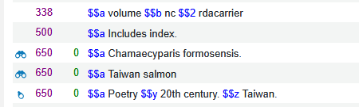
The difference between using F3 and not using F3
After saving the record the non-preferred term "Taiwan salmon" remains.
It did not change to preferred term "Oncorhynchus formosanus"
It did however link to the authority record (as indicated by the binoculars icon).
It will change to the preferred term when the job "Preferred Term Correction" runs.
Non-preferred term is linked to the authority record

Slide 44
The job "Preferred Term Correction"

Slide 45
The job "Preferred Term Correction"
The "Preferred Term Correction" job changes non-preferred terms to preferred terms for all bibliographic headings which are linked to an authority record and are in the non-preferred form.
For example, if a bibliographic record contains the non-preferred term "Taiwan salmon" and the associated authority record contains the preferred term "Oncorhynchus formosanus" then the "Preferred Term Correction" job will replace "Taiwan salmon" with "Oncorhynchus formosanus".

Slide 46
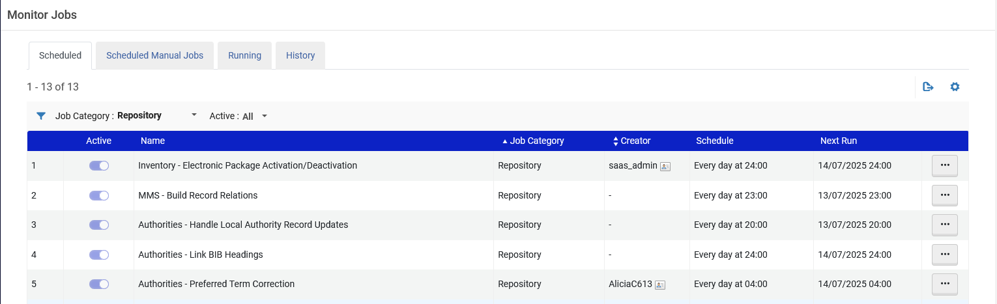
The job "Preferred Term Correction"
In order to see if this job is scheduled in your institution go to "Alma menu > Admin > Manage Jobs and Sets > Monitor Jobs". Switch to the "Scheduled" tab and filter by "Repository".
If the job is "active" then it is scheduled run as specified in the "Schedule" column.

Slide 47
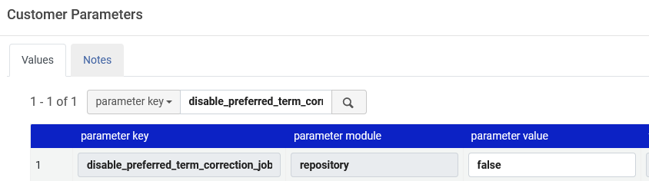
The job "Preferred Term Correction"
If the job "Preferred term correction" is not enabled in your institution, then you can enable it by changing parameter disable_preferred_term_correction_job to "false" at "Configuration Menu > Resources > General > Other Settings"

Slide 48
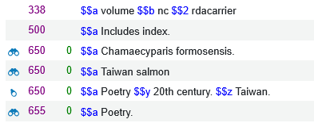
The job "Preferred Term Correction"
Our previous example still has the non-preferred term "Taiwan salmon" linked to the authority record
Non-preferred term is linked to the authority record

Slide 49
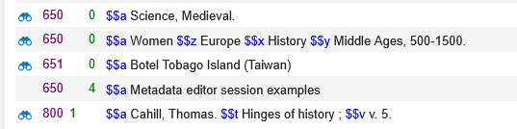
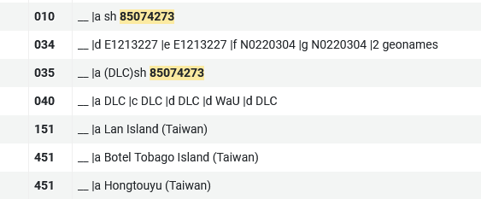
The job "Preferred Term Correction"
Another record has non-preferred term "Botel Tobago Island (Taiwan)".
The non-preferred term is linked an authority record.
The preferred term is "Lan Island (Taiwan)"

Slide 50
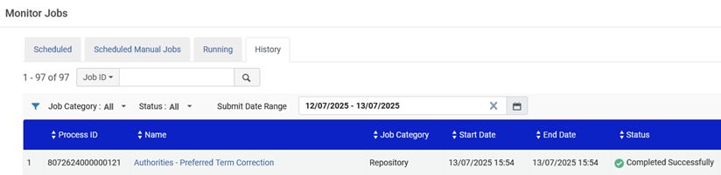
The job "Preferred Term Correction"
The "Authorities - Preferred Term Correction" job completes.

Slide 51
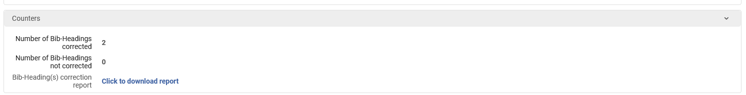
The job "Preferred Term Correction"
The job report shows that both headings have changed

Slide 52
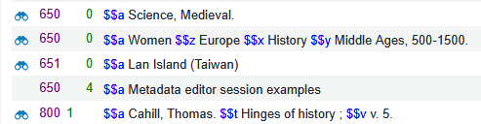
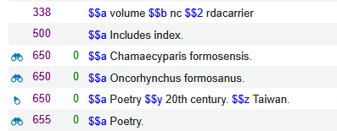
The job "Preferred Term Correction"
Both records now have the preferred term

Slide 53
What's the whole point? Why are we doing this?

Slide 54
What's the whole point? Why are we doing this?
At the beginning of this presentation, we stated as follows:
  The ultimate goal of authority control is not merely to engage in an academic exercise, but rather to ultimately aid the end user in finding desired material.
One significant way of aiding the end user in discovery and the staff user in Alma is to allow the "searcher" to search by the preferred term or by the non preferred term.

Slide 55
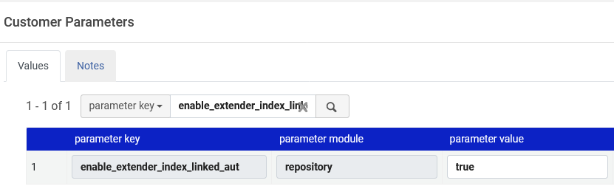
What's the whole point? Why are we doing this?
It is possible to search for and find a record via the non preferred term of the authority record if in Alma we have defined "true" for parameter enable_extender_index_linked_aut at "Configuration > Resources > General > Other Settings".
This parameter is also explained at Configuring Other Settings (Resource Management)

Slide 56
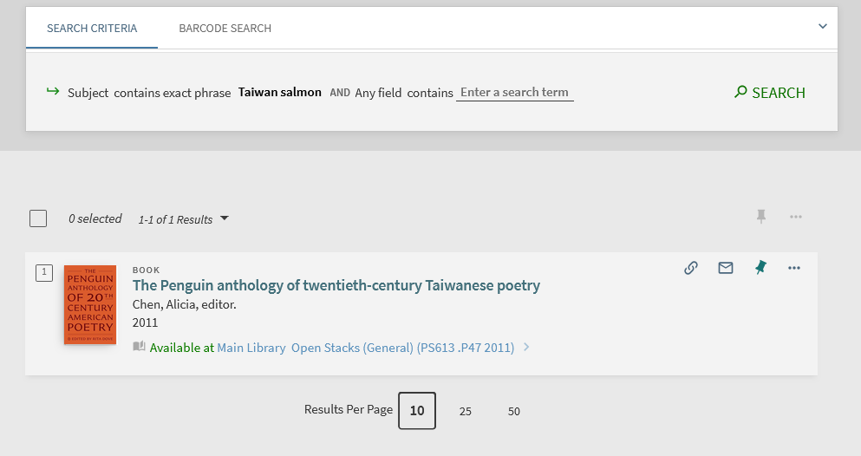
What's the whole point? Why are we doing this?
For example, if we search discovery for subject "Taiwan salmon" we find title "The Penguin anthology of twentieth-century Taiwanese poetry"

Slide 57
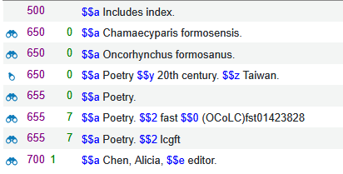
What's the whole point? Why are we doing this?
We found the record by searching for "Subject contains exact phrase Taiwan Salmon" even though "salmon" does not appear in any of the subjects

Slide 58
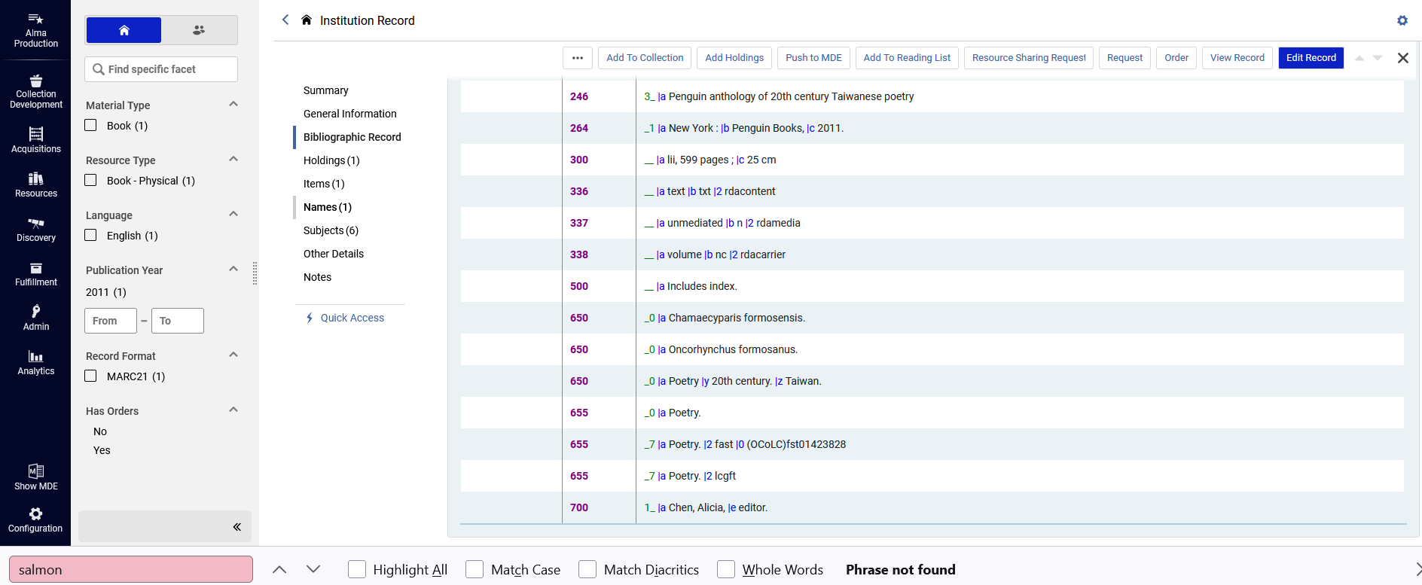
What's the whole point? Why are we doing this?
We found the record by searching for "Subject contains exact phrase Taiwan Salmon" even though "salmon" does not appear anywhere in the record

Slide 59
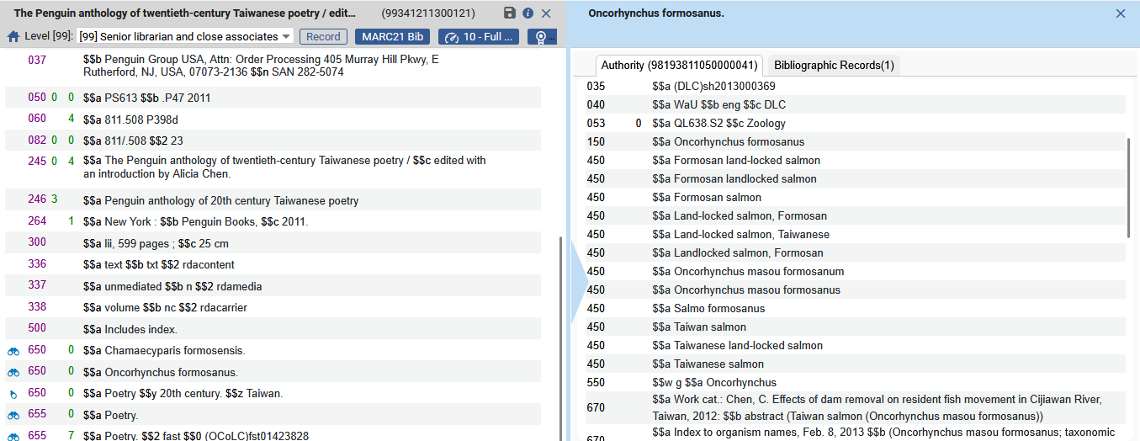
What's the whole point? Why are we doing this?
The reason we found the record is because "Taiwan salmon" is a non-preferred term from preferred term "Oncorhynchus formosanus".

Slide 60
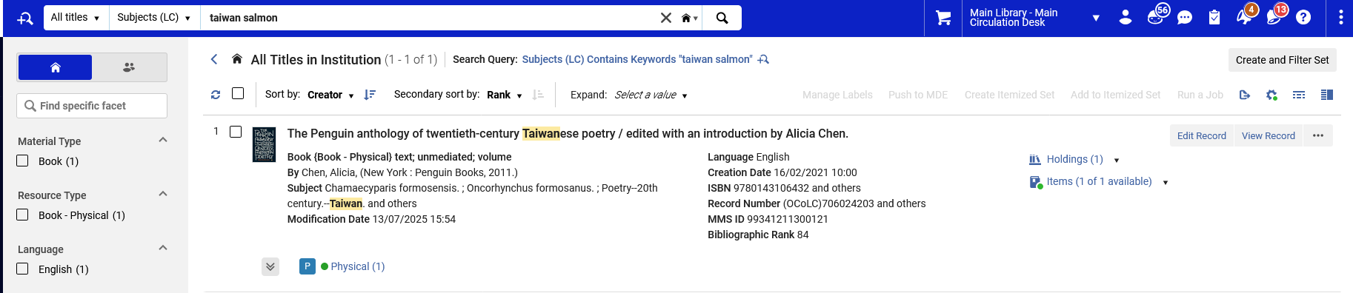
What's the whole point? Why are we doing this?
The record can also be found in Alma (not only in Primo) using the non-preferred term.

Slide 61
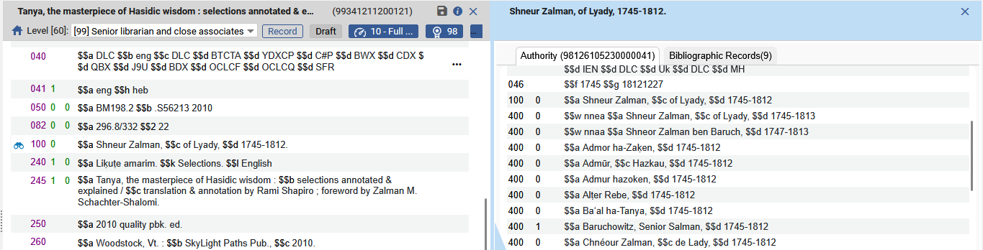
What's the whole point? Why are we doing this?
Here is another example. Title "Tanya, the masterpiece of Hasidic wisdom : selections annotated & explained" has author "Shneur Zalma of Lyady". This author is linked to an authority record which has non preferred term "Baruchowitz, Senior Salman".

Slide 62
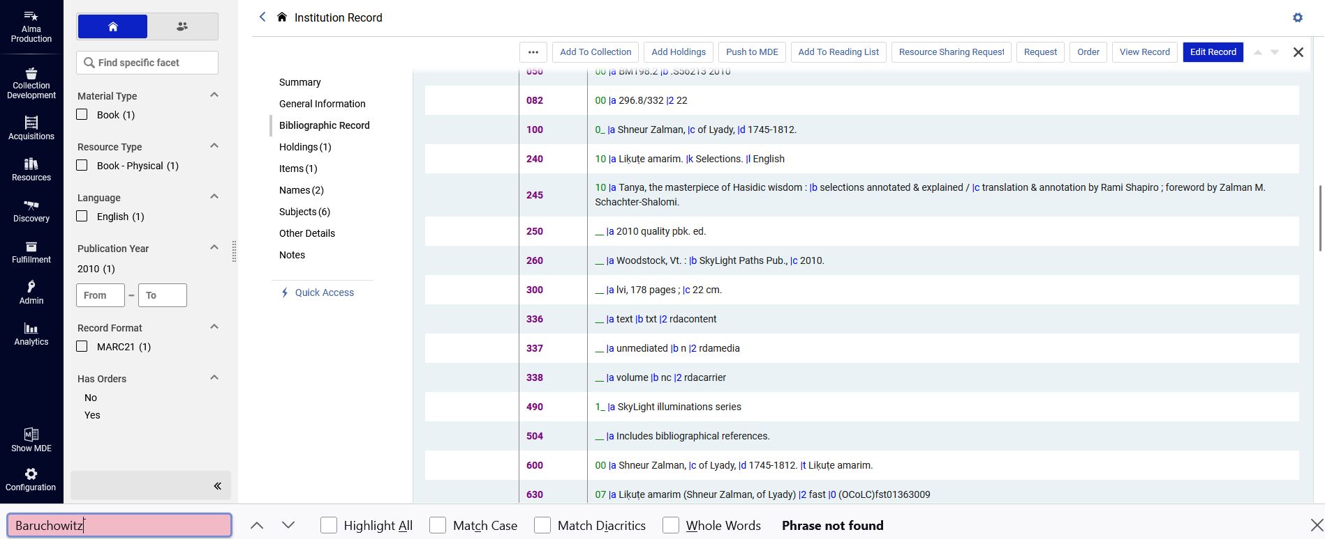
What's the whole point? Why are we doing this?
If we look at title "Tanya, the masterpiece of Hasidic wisdom : selections annotated & explained" we see that the "Baruchowitz, Senior Salman" does not appear in the record.

Slide 63
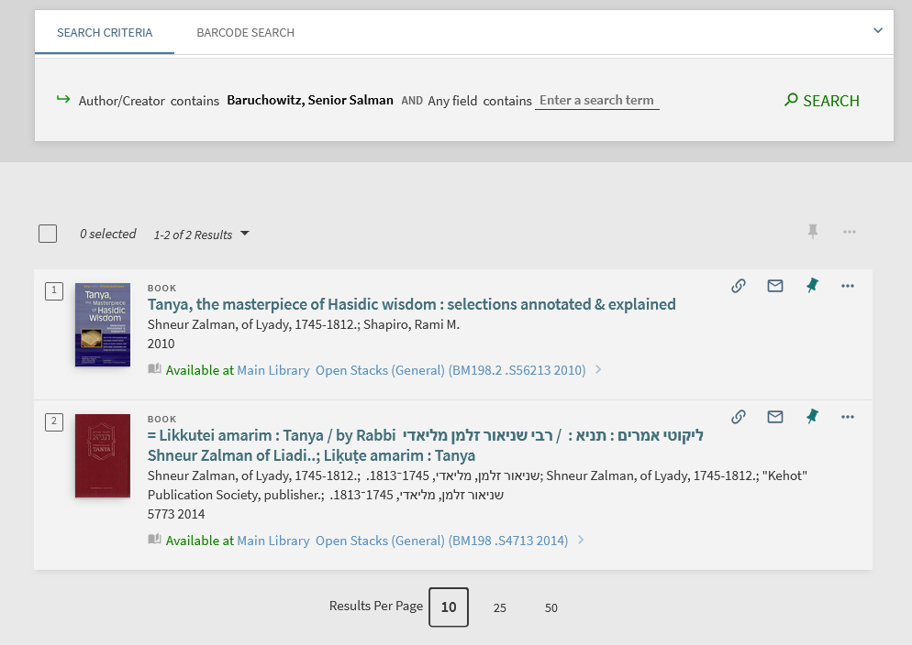
What's the whole point? Why are we doing this?
In discovery if we search for "Baruchowitz, Senior Salman" we find (via the non preferred term) title "Tanya, the masterpiece of Hasidic wisdom : selections annotated & explained".

Slide 64
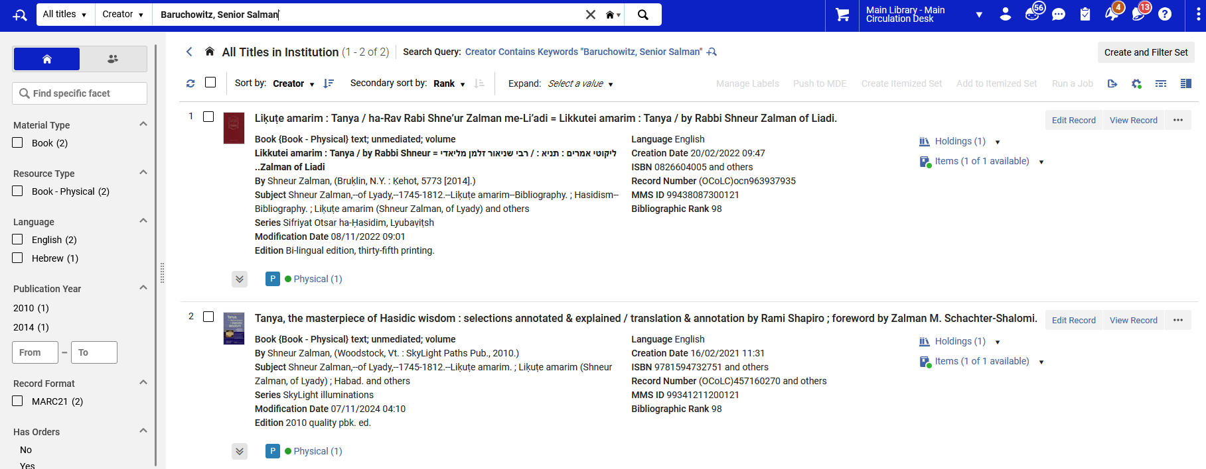
What's the whole point? Why are we doing this?
In Alma also if we search for "Baruchowitz, Senior Salman" we find (via the non preferred term) title "Tanya, the masterpiece of Hasidic wisdom : selections annotated & explained".

